Slide 1
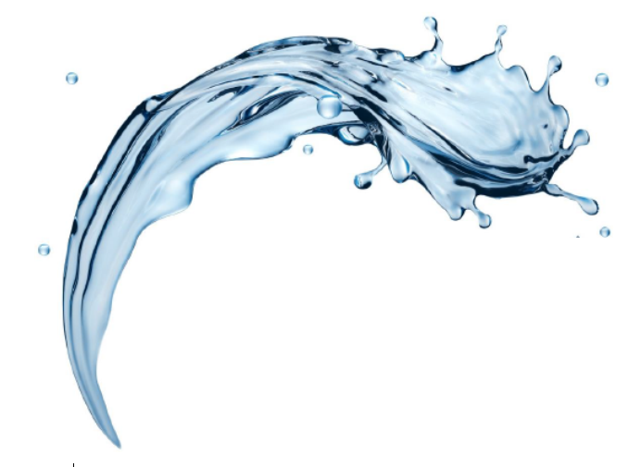

FilterSorb SP3
Introduction: Part I
-by Deepak Chopra

Slide 2

Introduction SP3
(S) SCALE (P) PREVENTION (3) Ca(HCO3)2soluble
changes
Temporary Hardness
into
Calcium Carbonate + Pure Water+ Carbon dioxide
CaCO3+ H2O+ CO2
This is the Definition of FILTERSORB SP3
Introduction SP3
A. Science is the description of world based on MEASURABLE FACTS, [DATA] and the formulation of TESTABLE Explanations How the hard water operates WORKS.

Slide 3
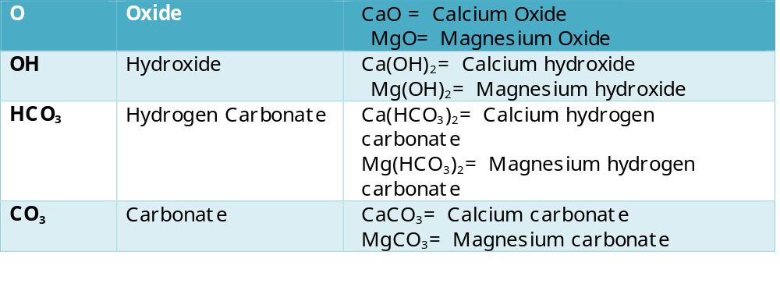
Science and the Scientific Method of SP3
FACTS HARD WATER
[DATA] Calcium Carbonate CaCO₃
“ a very useful materials”
“and the FORMULATION Calcium and Magnesium compounds are both
M = Metals Caor Mgsame group 2 (periodic table), similar properties” TESTABLE explanations

Slide 4
Science and the Scientific Methode of SP3
B. Assumptions (axioms) of science:
1.The water behaves chemically, governed by a natural order(H+) Hydrogen + (OH-) Hydroxides = H2O
2.There is a cause and effect relationship behind every SCALE happening
•One might ask, where did the scale come from?
•What was the original cause?
CAUSE
Water + Carbon dioxide + Calcium + Magnesium + Oxides + Hydroxides + Hydrogen carbonate, made water hard is called
TEMPORARY HARDNESS
H2O + CO2+ Ca + Mg + O + OH + HCO3and after saturation Ca(HCO3)2
And the Temporary Hardness exist is a scientific fact.

Slide 5
Hard and Soft Water
1.The scientific method to test Hard watervs. Soft water
SOAP TEST
It is very important to know what “Soap” is?
“SOAP” is not “detergent“
Soap in hard water makes “scum” but not detergents. NOTE detergents usually give a very good lather with any water. With soft water you never get rid of soap from your body and left over soap causes skin diseases (Read Case Study). All detergents are SOAPLESS. Scum is because of Gypsum, which are mainly Calcium Sulfate CaSO4.

Slide 6
Soap Test
SOAP is “Natural Sodium Stearate
”The chemistry of “Scum” formation
Calcium Sulfate + Sodium Stearate→Calcium Stearate+ Sodium Sulfate
(Hardness) (soap) (scum)
Formulationthe scientific method
CaSO4+ 2C17H35COONa Ca( C17H35COO)2+ Na2SO4
ConclusionTestable explanation of “Clear Yellow” Test Kit
•A precipitation reaction is generally defined as the formation of insoluble solid, one before the SP3system and after the SP3system
Clear Yellow Test | Inlet | Outlet
Condition | Not dissolved | Dissolved
Visual appearance | Tubid | Clear

Slide 7
Testable Explanations
C. The scientific method: Answering questions
Using Testable explanations
1.Ask questions why SP3is better?
  Why water softener treatment is so expensive?
  Why do human beings need water?
  What causes high blood pressure?
  Why calcium is so important?
  Why magnesium deficiency is dangerous?
  What causes cancer?
  How do soft water causes cardiovascular diseases?
  What is a saturated solution and solute in water?
  What causes eczema?

Slide 8
Testable Explanations
2. SP3 treatment offers a tentative explanation that can be TESTED
Solubility of Calcium and Magnesium compounds and their reactions
•Solvent: the liquid that dissolves the material in test.
•Solute: the material which is to be dissolved in a solvent in test bottle.
•Solution: the result of the dissolving in the test water. Solute + Solvent = Clear solution
•Solubility: to what extent a test powder (solute) will dissolve
•Soluble: the material or test powder will dissolved in good water
•Insoluble: not soluble, will not dissolve in a SP3 water i.e. Calcium Sulfate(CaSO4) and Magnesium Sulfates (MgSO4)
Note: The solution of CO2(aq.) is sometimes described as “Carbonic acid” H2CO3 but this does not really exist! CO2(aq.) + H2O ↔ H+(aq.) + HCO3-(aq.)

Slide 9
Testable Explanations
Solubility of Calcium and Magnesium compounds and their reactions (continues)
•Saturated: means saturated solution in one in which solute will not dissolve
Calcium sulfate saturated water will not dissolve test powder
Calcium and magnesium oxides or hydroxides are soluble in H2CO3 water till gets saturated Ca(HCO3)2
These are the major cause of scale and alkaline solutions
Calcium carbonate and magnesium carbonate both are insoluble in water, but they are readily dissolves in acids. pH of the water remains same, alkalinity of the water remains same.

Slide 10
Facts
C. Step 3: Collect the DATA FACTS
Note:UsingIon-exchange for hard water increase costs because sodium chloride or hydrochloric acid is needed to make a regeneration and this leads to high sodiumions in water or hydrogen ions which reduces the pH of water.
•CaCO3+2HCl --------→ Ca2+(Cl-)2+H2O+CO2
•CaCO3+2NaCl ---------→ Ca2+(Cl-)2+H2O+2Na+ However, a negative point! Sodium ions and hydrogen ions both causes high blood pressure and acidic body cells and can cause cancer and this is not a Hypothesis or a Theory but a Scientific fact. The test study should be identical in all ways.

Slide 11
Facts
CaseStudy:
Acid ssolutions have a pH of<6.8. These are quite often of salts, which are themselves formed from neutralizing acids and bases. That is the reason the pH sinks when crystallization takes place. Example: Template Assisted Crystallization (TAC). Because all acids from hydrogen ions in the water and with this the remaining ions that is Calcium (Ca2+) and Chlorides (Cl2-) becomes the salt of Ca Cl2 and the same reaction takes place with magnesium (Mg2+) and chlorides (Cl2-) becomes MgCl2 and this is true.
FACTS that in all acids there are more H ions and with chlorides it makes HCl hydrochloric acid. The main cause and the only cause of corrosion and it is a scientific FACT.

Slide 12
Nucleation Assisted Crystallization (NAC)
•NAC Is different than other crystallization process of water crystallization. A solid heterogeneous catalyst that reacts with a water and gaseous/solutions.
•The reaction occurs on the SP3 surface which is a glass surface coated on Calcium and ceramic beads. The reactants are absorbed onto the catalyst SP3 surface at the “active sites” cracked glass surface. These reactants are physical adsorbed and very “weakly” bounded to the SP3 surface. When the high concentrations of the reactants are very close to each other and weakening the original molecular bonds within the reactants ions are separated in seconds with a great success of “fruitful” collision.

Slide 13
Hydrogen Carbonate Ion (HCO₃-)
The hydrogen carbonate ion as
HCO3Ca(HCO3) 2CaCO3+ H2O + CO2
insoluble calcium carbonate, Pure Water and CO2 as gas and on the surface of SP3 the carbonate ionsC O3²⁻acting as a base, gains two protons to form
H2O + CO2+ Ca2+
these are separated on the surface of SP3, CO2 in this formula is acting as supersaturated CO2 and the Ca starts Nucleation process and becomes crystals.
SP3

Slide 14
Hydrogen Carbonate Ion (HCO₃⁻)
Incidentally, H2O is a neutral oxide because its pH is 7. Logistically the oxonium/hydrated proton ion concentration equals to the hydroxide ion concentration.
The strength of adsorption is very important to have a very smooth surface and SP3 has a glass surface.
WATER Oxonium/ Hydrogen ion + Hydroxide ion
But, in this reaction, water acts as but both ACID and BASE i.e, one water molecule acid donates a proton to another water molecule which becomes an oxoniumion (hydrated proton) and another water molecule (base) simultaneously accepts a proton!
Therefore, water is an amphoteric oxide: That is it reacts as both a proton acceptor and a proton donator.
2H2O <-> (H3O+) + (OH-)
(And this is a scientific fact)

Slide 15
Hydrogen Carbonate Ion (HCO₃⁻)
Now the hydrogen carbonate ionH CO3-Can act as a carbonate ion both as ACID with a Base or act as a base with an acid, such behavior is described as amphoteric
HCO3-acting as a base, accepting a proton from an acid.
HCO3-+ OH- H2O + CO2
HCO3- acting as an acid donating a proton to the hydroxide ion base
MORE SIMPLE: the reactant Ca(HCO3)2 bounding to the SP3 catalyst glass surface (chemisorptions/adsorption) must be very strong to apart reactant ions as fast as possible but enough to handle all ions and the products to “escape” from the SP3 surface its called (desorption process).
Nucleation Adsorption
Assisted Desorption
Crystallization in one process

Slide 16
SP3 functionality
In SP3 NAC process the very expensive ceramic beads are used. Glass coating is very unusual on the catalyst but it is holding to keep the maximum surface area to give the greatest and therefore the most efficient rate of reaction. This means the catalyst SP3 must be physically supported by glass surface distributed with very high temperature on ceramic support. All other medias available in the industry expands and have very less active sites on the catalyst surface. It considerably reduces the efficiency of the product.
Example: Template assisted media (TAC) expands to double of its original size loosing the Active sites for reaction.

Slide 17
SP3 Poisoning
Actives Sites: Not all the surface of the media is effective due to minute imperfections in Ca2+crystal at the ionic level. For any catalytic surfaces, this is desired to have cracked surfaces before they are much more effective than the rough expanded ones.
Important: SP3 catalyst poisoning should be avoided if at all possible.
High Copper and high content of Iron can cause these impurities, as they can be bounded on the SP3 active sites of the surface. It considerably reduces the efficiency of the SP3, especially as the most effective SP3 catalyst sites bind impurities the strongest, competing with the reactant Ca(HCO3)2 ions.
Hydrogen sulfides poisons the SP3 media, so precautions should be taken that water contains no sulfur.
Commercial systems have to replace media every 3 years.

Slide 18
Conclusion
Case Studies:
•Boilers
•Heat exchangers
•Cooling Towers
•Commercial applications
Reminder:What FILTESORB SP3 is and how does it work?
SP3 is a media that alters the rate of scale prevention without any regeneration or use of chemicals. It takes part in the reaction and change hardness into non effective and harmless crystals.
End of Part I
Thanks for reading!

Slide 19
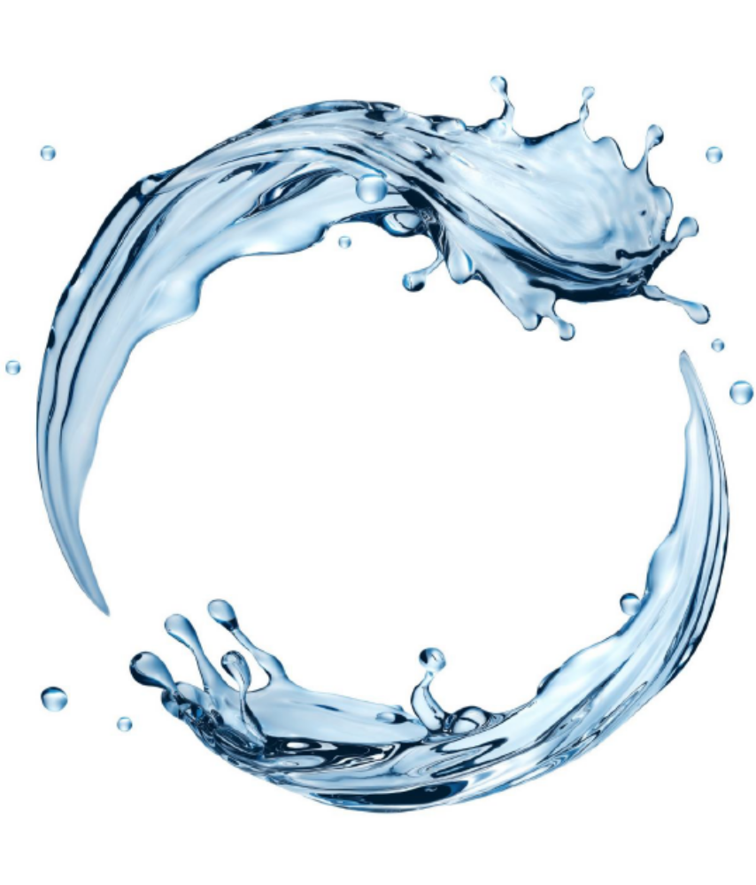

Watch Water® GmbH
Fahrlachstraße 14
68165 Mannheim
Germany
www.watchwater.de
info@watchwater.de
+49 (o)621 87951-0

